Slide 1
Ensemble Learning

Slide 2
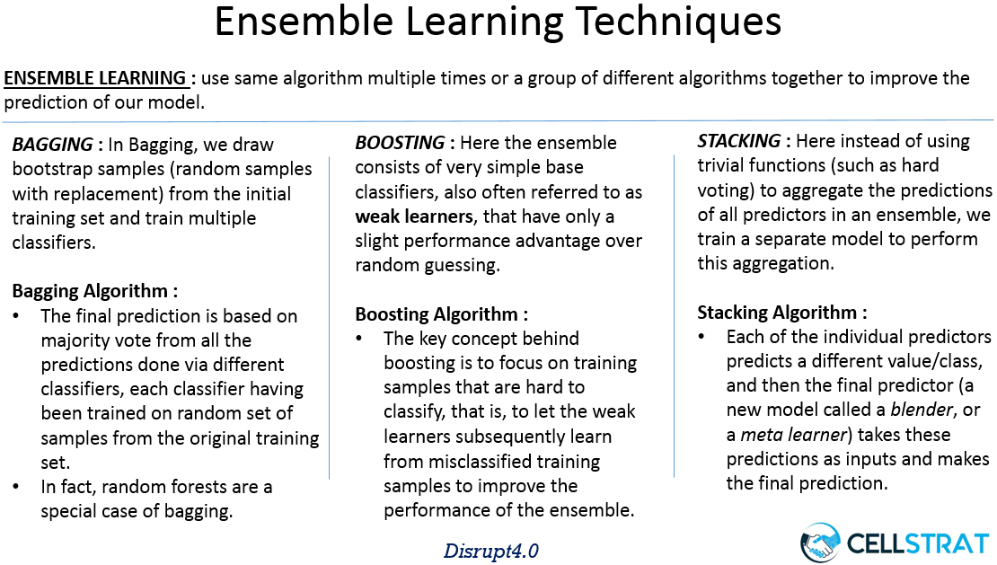
https://www.google.co.in/search?rlz=1C1CHZL_enIN768IN768&biw=1366&bih=646&tbm=isch&sa=1&ei=0F37W7vMH8bkvgT5jrLgBw&q=what+is+boosting+ensemble&oq=what+is+boosting+ensemble&gs_l=img.3...5140.7753..7895...0.0..0.116.986.0j9......0....1..gws-wiz-img.......0i24.kszK22XGThI#imgrc=GgwPT3uNodzOEM:

Slide 3
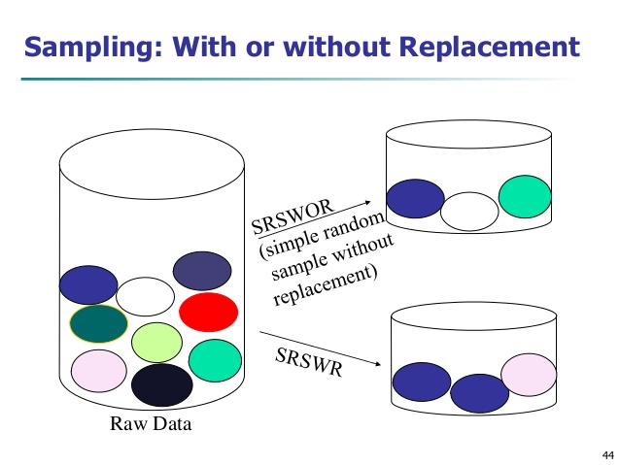
https://www.google.co.in/search?q=bootstrapping+statistics&rlz=1C1CHZL_enIN768IN768&source=lnms&tbm=isch&sa=X&ved=0ahUKEwjnzZuchPHeAhUJp48KHQxmDQYQ_AUIDygC&biw=1366&bih=646#imgdii=DypieZCD7YURVM:&imgrc=gWmklBsE3_HgCM:

Slide 4
reference
https://data-science-blog.com/blog/2017/12/03/ensemble-learning/

Slide 6
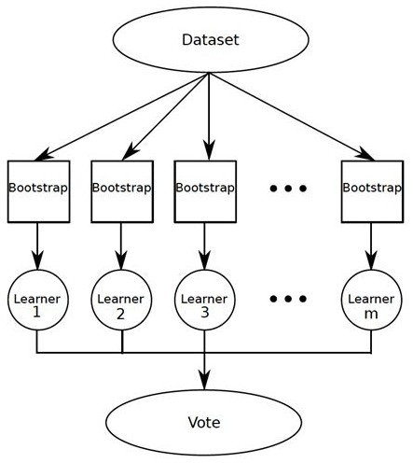

Slide 9
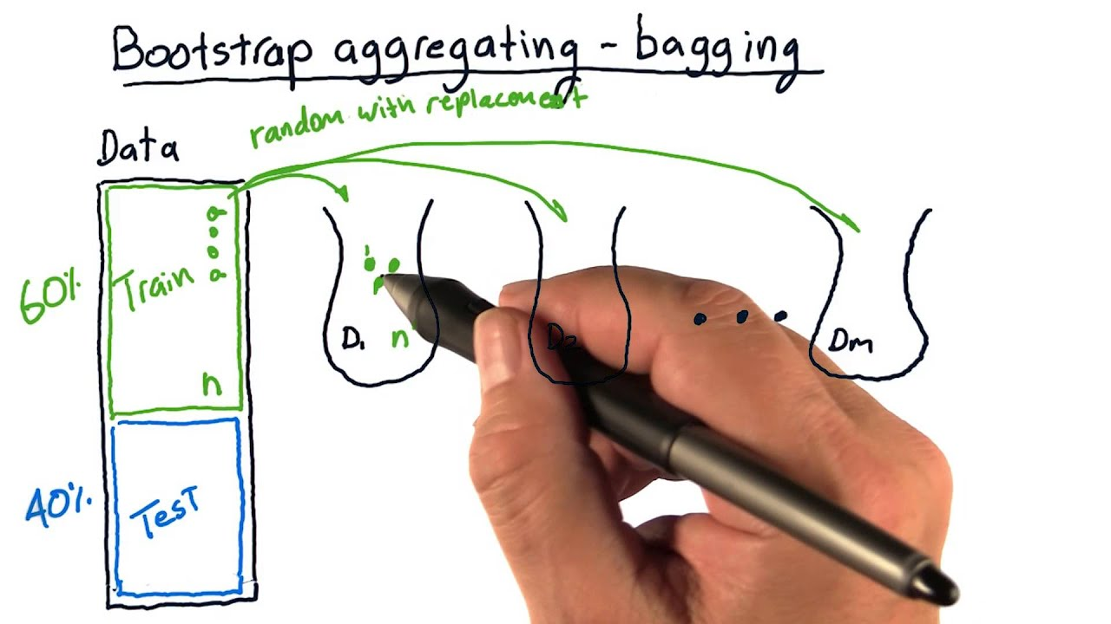
https://www.google.com/search?q=what+is+bagging+or+bootstrap+aggregating&source=lnms&tbm=isch&sa=X&ved=0ahUKEwi4tfnLg_HeAhXMvo8KHZCMAiYQ_AUIDigB&biw=1366&bih=646#imgrc=Drcb2vKbsH5WiM:

Slide 10
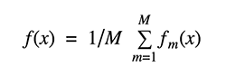

Slide 11
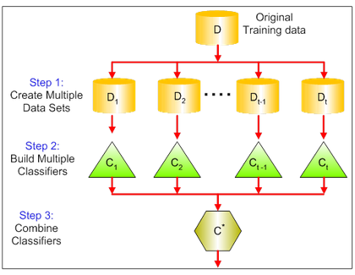
https://www.google.co.in/search?rlz=1C1CHZL_enIN768IN768&biw=1366&bih=646&tbm=isch&sa=1&ei=0F37W7vMH8bkvgT5jrLgBw&q=what+is+boosting+ensemble&oq=what+is+boosting+ensemble&gs_l=img.3...5140.7753..7895...0.0..0.116.986.0j9......0....1..gws-wiz-img.......0i24.kszK22XGThI#imgrc=503xjLL3CZ2sqM:

Slide 12
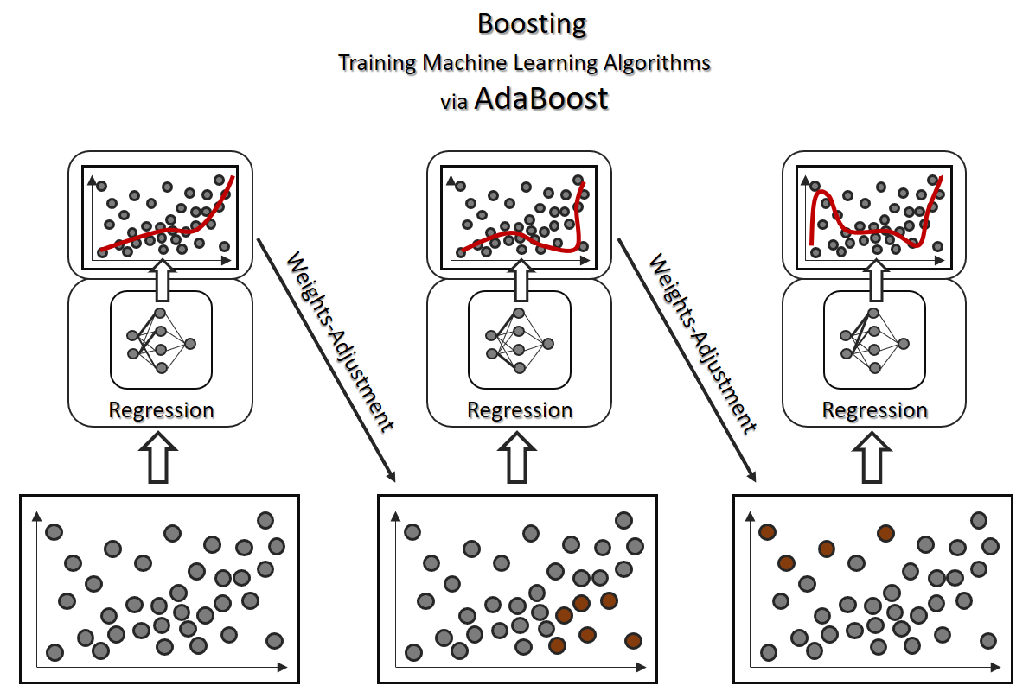

Slide 13
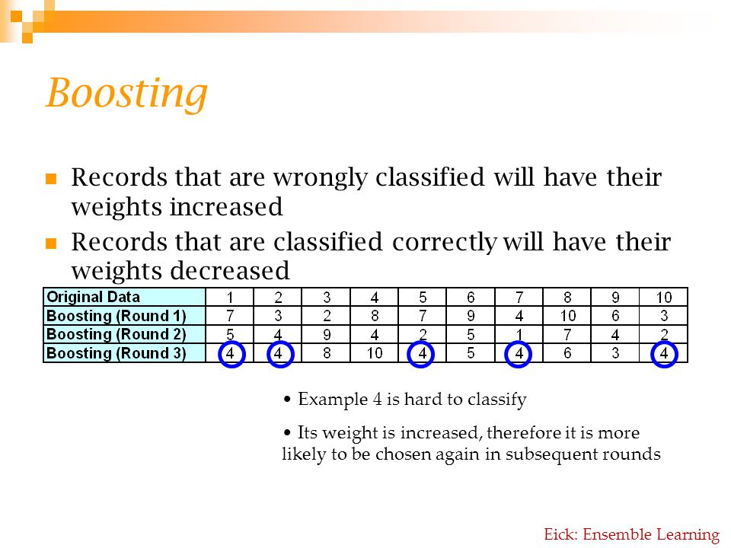
https://www.google.co.in/search?rlz=1C1CHZL_enIN768IN768&biw=1366&bih=646&tbm=isch&sa=1&ei=0F37W7vMH8bkvgT5jrLgBw&q=what+is+boosting+ensemble&oq=what+is+boosting+ensemble&gs_l=img.3...5140.7753..7895...0.0..0.116.986.0j9......0....1..gws-wiz-img.......0i24.kszK22XGThI#imgrc=VlNtVJhoZf7HkM:

Slide 14
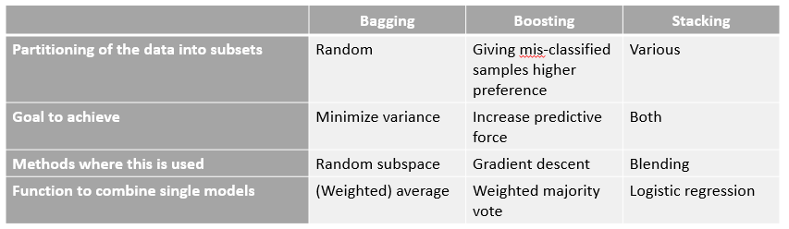
https://www.google.co.in/search?rlz=1C1CHZL_enIN768IN768&biw=1366&bih=646&tbm=isch&sa=1&ei=0F37W7vMH8bkvgT5jrLgBw&q=what+is+boosting+ensemble&oq=what+is+boosting+ensemble&gs_l=img.3...5140.7753..7895...0.0..0.116.986.0j9......0....1..gws-wiz-img.......0i24.kszK22XGThI#imgrc=_AI5P1OFTqbZHM:

Slide 17
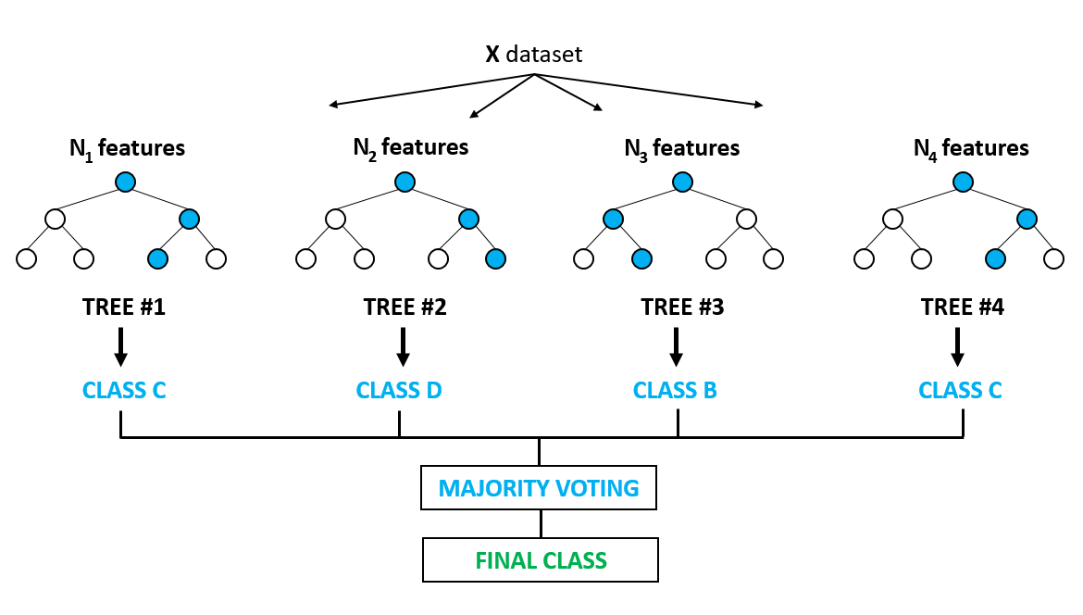
https://www.google.com/search?biw=1366&bih=695&tbm=isch&sa=1&ei=Srj6W_ntEsTjvgS1m67YBA&q=random+forest&oq=random+forest&gs_l=img.3..0j0i67j0l8.64637108.64639943..64642021...1.0..0.253.2740.0j11j3......0....1..gws-wiz-img.......0i10i24.bTHH8RmvTvE#imgrc=QrY18jNEX-Ya5M:

Slide 18
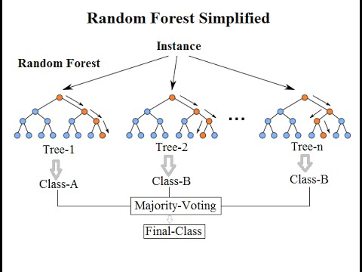
https://www.google.com/search?biw=1366&bih=695&tbm=isch&sa=1&ei=Srj6W_ntEsTjvgS1m67YBA&q=random+forest&oq=random+forest&gs_l=img.3..0j0i67j0l8.64637108.64639943..64642021...1.0..0.253.2740.0j11j3......0....1..gws-wiz-img.......0i10i24.bTHH8RmvTvE#imgrc=vLpkcbzFBIJhjM:

